Slide 1
Guideline for Analysis
on Stand-Alone Tire Data
2024/12/9

Slide 2
Purpose
Since tire hitting sounds from trucks are sometimes distorted due to a few reasons, let’s analyze the relationships between hitting pulse widths and air pressure.
All info for analysis is here.
https://www.dropbox.com/scl/fo/fqle57kxhqrubcqx6755e/ABzQws5GFMZxWHybeMKN_98?rlkey=f23k8z84fbwndatwplugj575q&dl=0

Slide 3
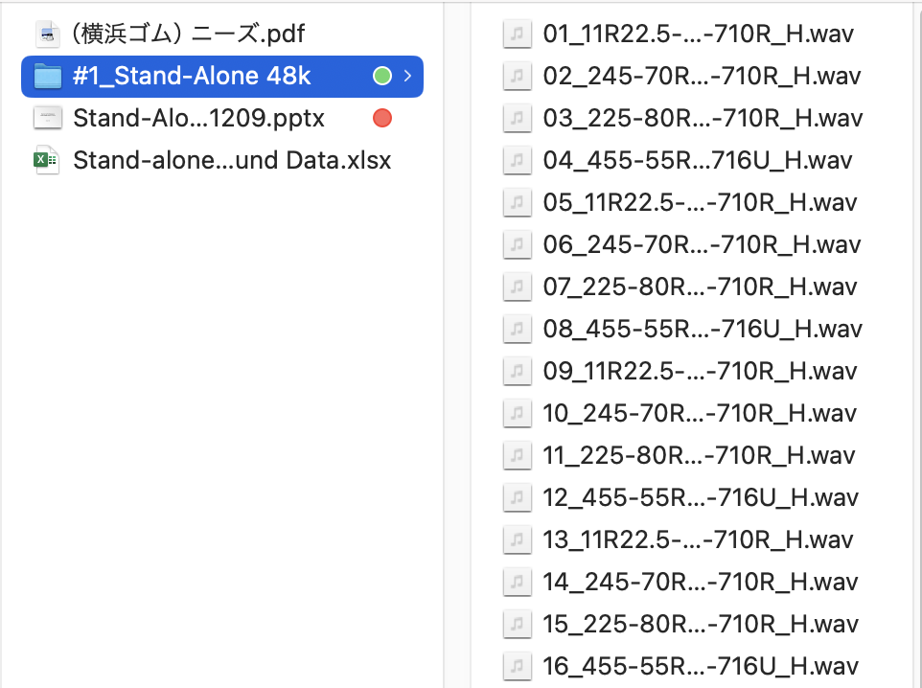
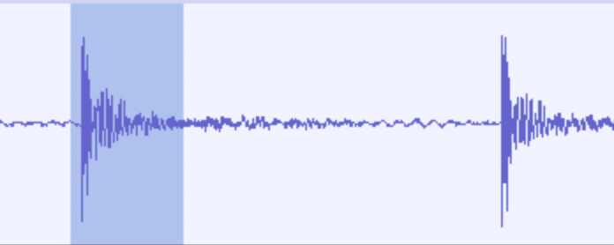
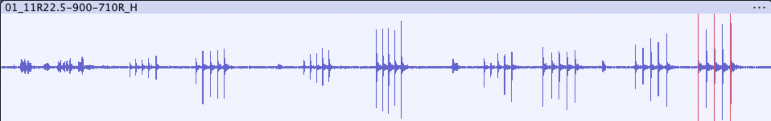
Making segments data
The original data folder is #1.
There are 63 files.
Average every 24 dimensions data.
2000 Hz sampling data (1,000Hz frequency bandwidth.
Use only Person A & Tread & Strong data.
5 hitting x 63 = 315 segments.
Select 256 dimensions data including the hitting sound pulse.
Convert segments data from Wav to Intensity.
Zero-offset.
Calculate the square of each dimension value.
Segments
63 groups each has 5 segments.
Person A
Person B
Tread
Side
Tread
Side
Weak Strong
Weak Strong
Weak Strong
Weak Strong

Slide 4
Pulse-Width Calculation
Power Normalization of segment data.
Pulse width calculation.
At 50%, 70%, 80%, and 90% levels.

